Slide 1

Generic Smartphone Game Controller Quentin Flückiger Spring 2019

Slide 2
Have you ever seen such a scene ?

Slide 3
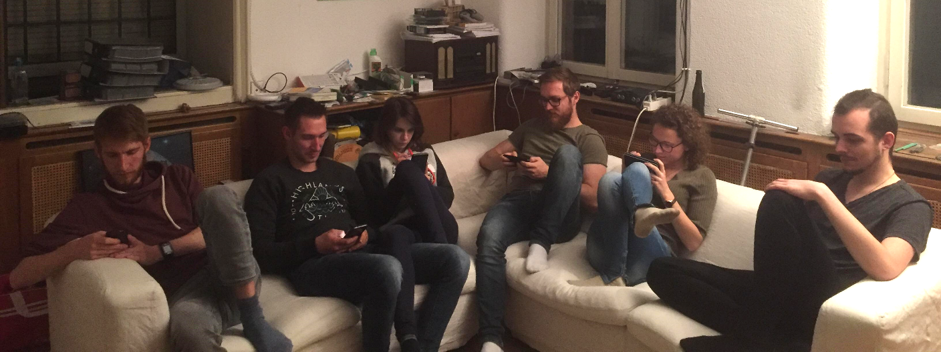

Slide 4
And thought they were wasting time while together ?

Slide 5
But what if we could use our smartphone as a link to play together?

Slide 6
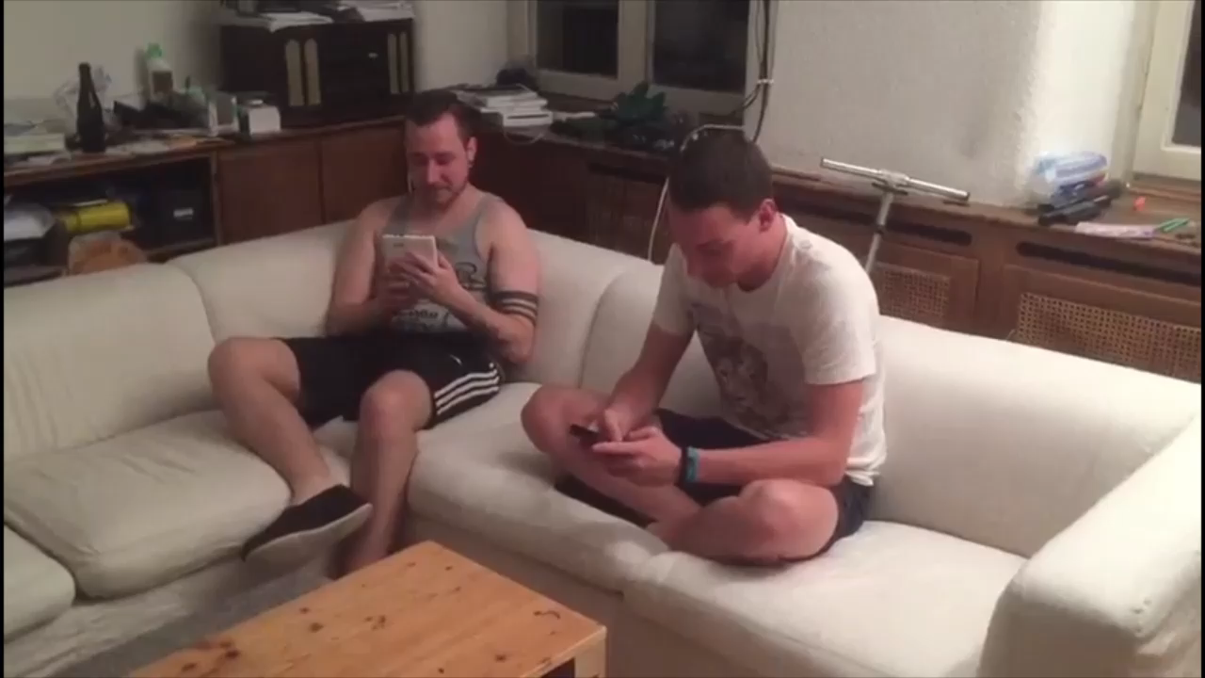

Slide 7
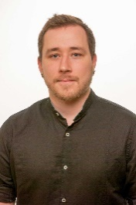
Quentin Flückiger

